Slide 1


Inter-networking Devices: Distinguishing of Networking Devices and Inter-networking Devices
Network protocols & security
24EC2210
Topic:
Design issues of Network layer
Session – 13

Slide 2
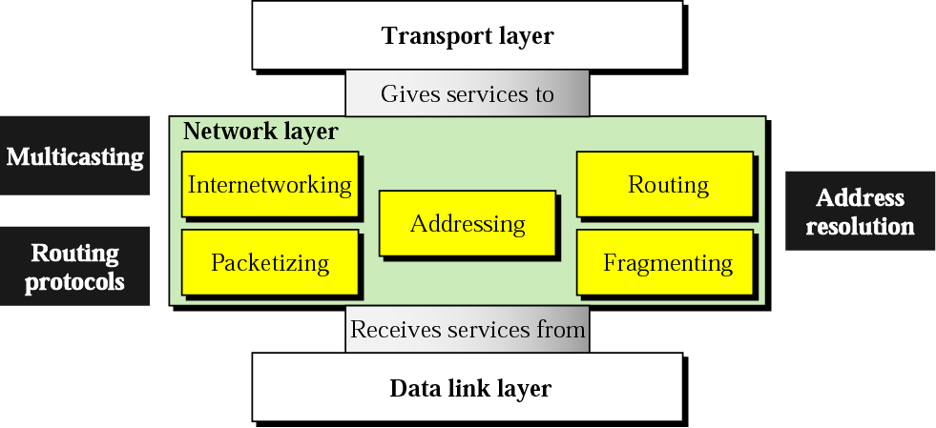
Position of network layer

Slide 3
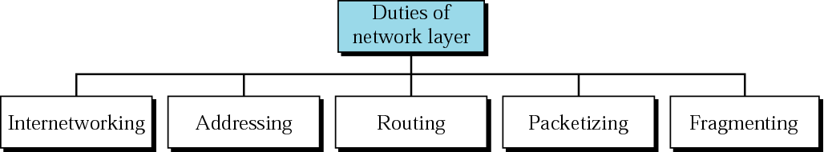
Network layer duties

Slide 4
Host-to-Host Delivery:
Internetworking, Addressing, and Routing

Slide 5
Internetworks
Need For Network Layer
Internet As A Packet-Switched Network
Internet As A Connectionless Network

Slide 6
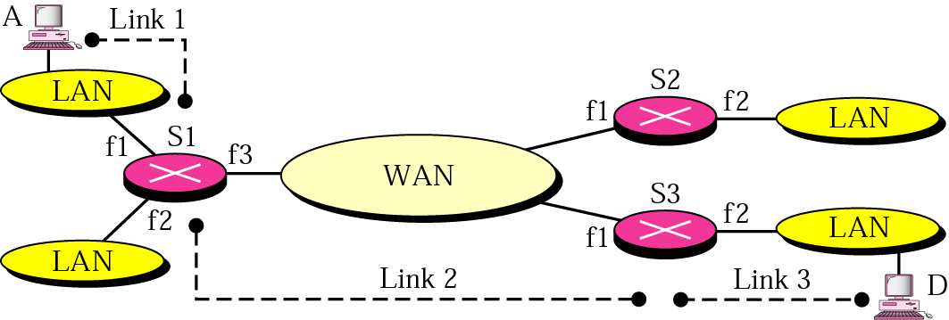
Figure Internetwork

Slide 7
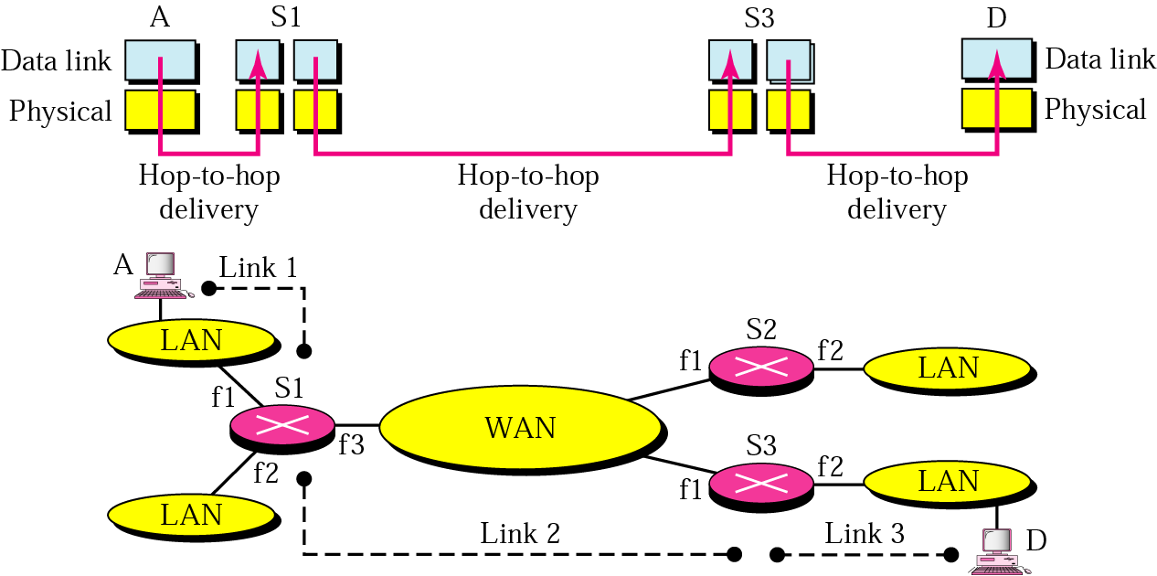
Figure Links in an internetwork

Slide 8
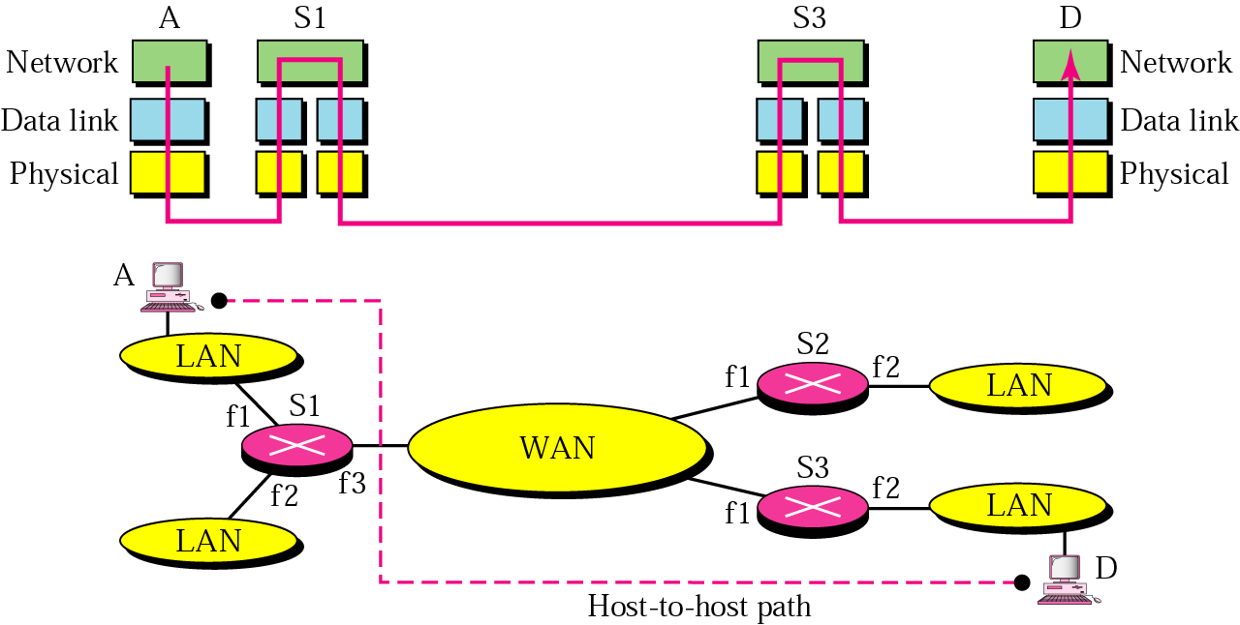
Figure Network layer in an internetwork

Slide 9
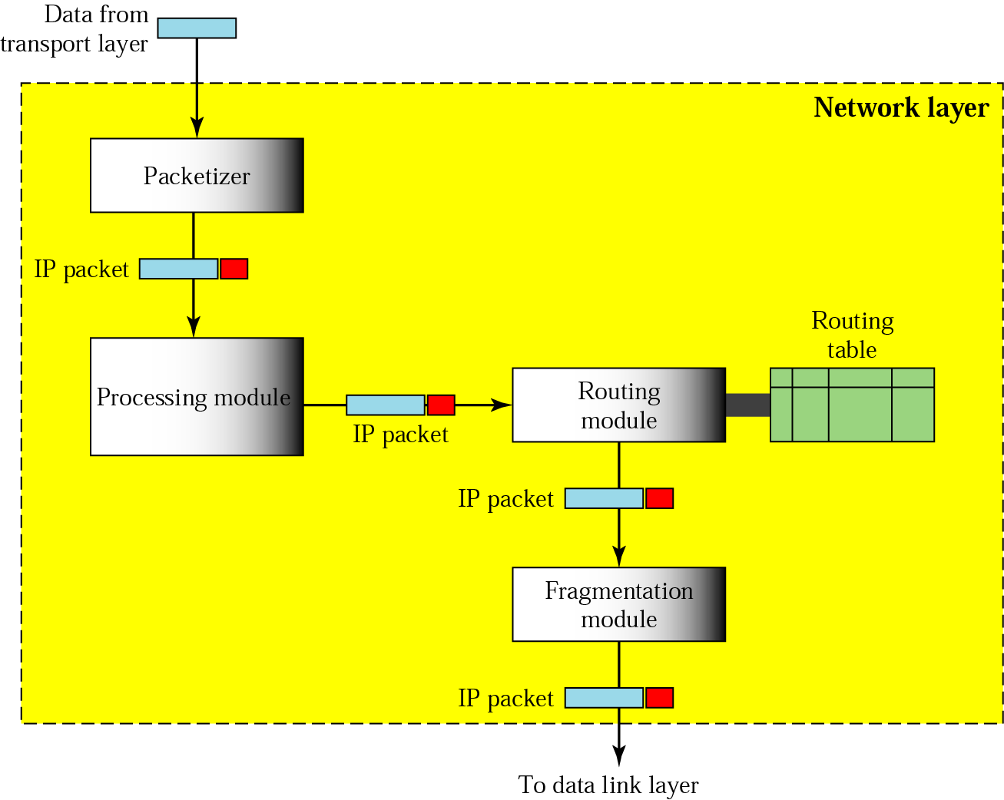
Figure Network layer at the source

Slide 10
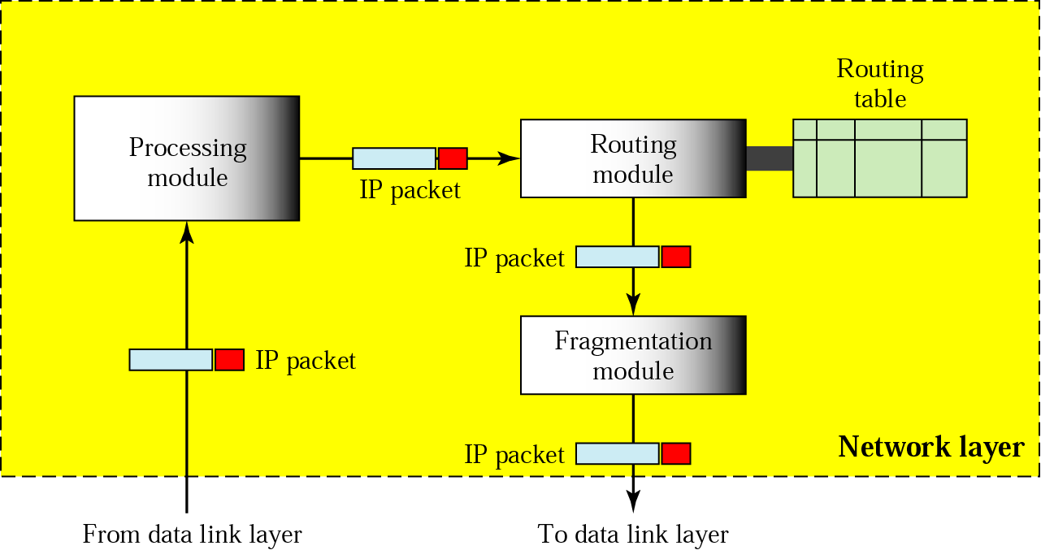
Figure Network layer at a router

Slide 11
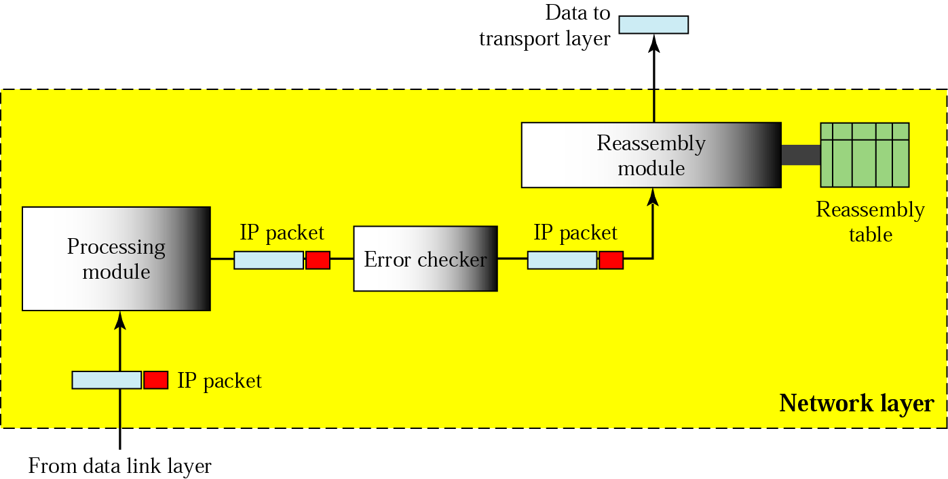
Figure Network layer at the destination

Slide 12
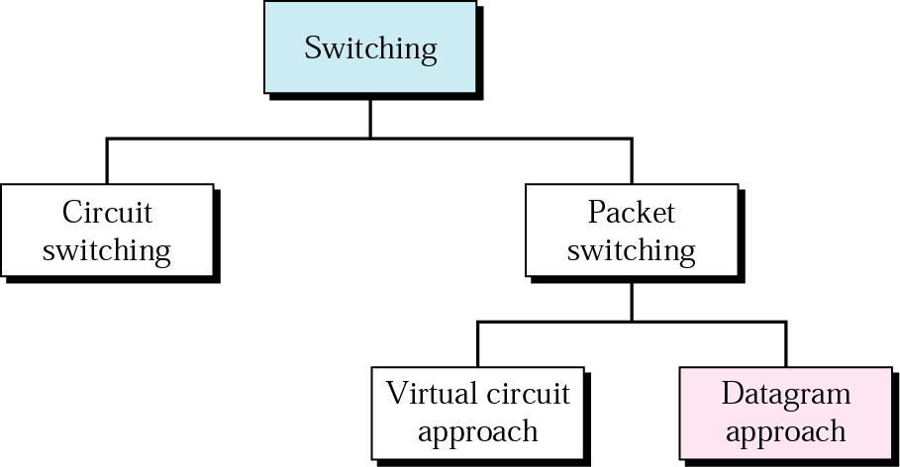
Figure Switching

Slide 13
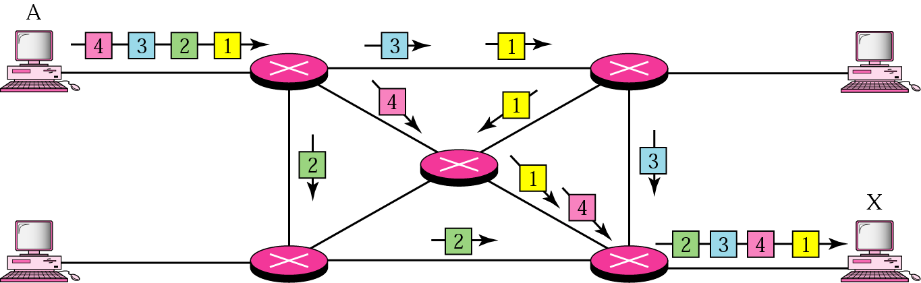
Figure Datagram approach

Slide 14
Note:
Switching at the network layer in the Internet is done using the datagram approach to packet switching.

Slide 15
Note:
Communication at the network layer in the Internet is connectionless.

Slide 16
Network Layer Design Issues
Store-and-forward packet switching
Services provided to transport layer
Implementation of connectionless service
Implementation of connection-oriented service
Comparison of virtual-circuit and datagram networks

Slide 17
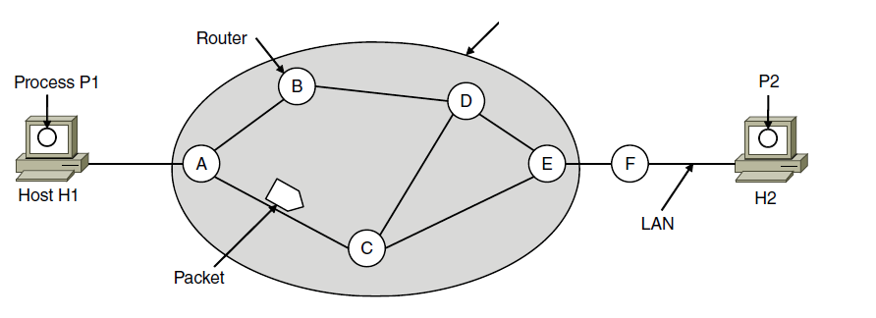
Store-and-Forward Packet Switching
ISP’s equipment
The environment of the network layer protocols.

Slide 18
Services Provided to the Transport Layer
Services independent of router technology.
Transport layer shielded from number, type, topology of routers.
Network addresses available to transport layer use uniform numbering plan
even across LANs and WANs

Slide 19
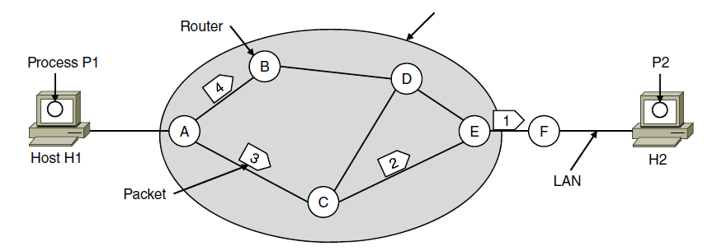
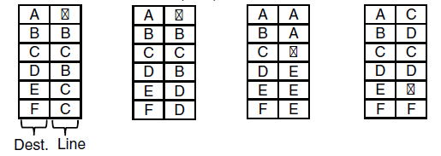
Implementation of Connectionless Service
ISP’s equipment
A’s table (initially) A’s table (later) C’s Table E’s Table
Routing within a datagram network

Slide 20
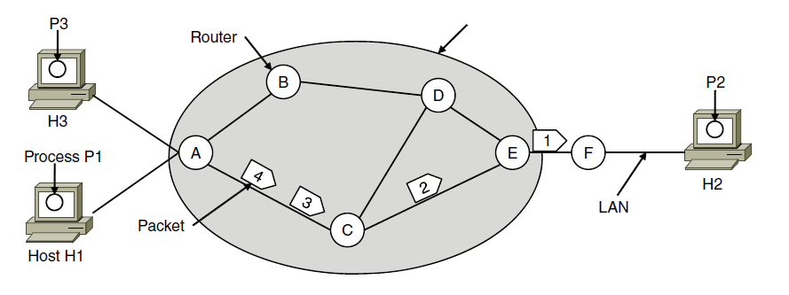

Implementation of Connection-Oriented Service
ISP’s equipment
A’s table C’s Table E’s Table
Routing within a virtual-circuit network

Slide 21
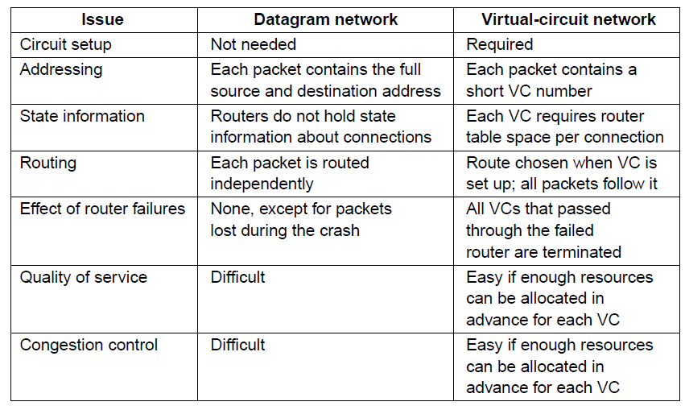
Comparison of datagram and virtual-circuit networks

Slide 22

SUMMARY
Design issues of Network Layer
Services provided by network layer
Connection-oriented and connectionless services.

Slide 23
TERMINAL QUESTIONS
1. Describe the design issues of Network layer.
2. Explain the implementation of connection-oriented and connectionless services by network layer.
3. Compare virtual circuit and datagram subnet.

Slide 24
REFERENCES FOR FURTHER LEARNING OF THE SESSION
Reference Books:
Behrouz A. Forouzan , “Data Communication and Networking”, TMH, 5th Edition, 2012.
A.S. Tanenbaum, David J. Wetheral “Computer Networks” Pearson, 5th Edition.

Slide 25
THANK YOU
Team – Network Protocols & Security

